Slide 1
Experience and Lessons from Building and Teaching a Serverless Solution
Second International Workshop on Serverless Computing (WoSC) 2017, ACM/IFIP/USENIX Middleware 2017
Donald F. Ferguson
Adjunct Professor, Dept. of Computer Science, Columbia University
Co-founder and CTO, Sparq TV
dff@cs.columbia.edu, donald.ferguson@seeka.tv

Slide 2
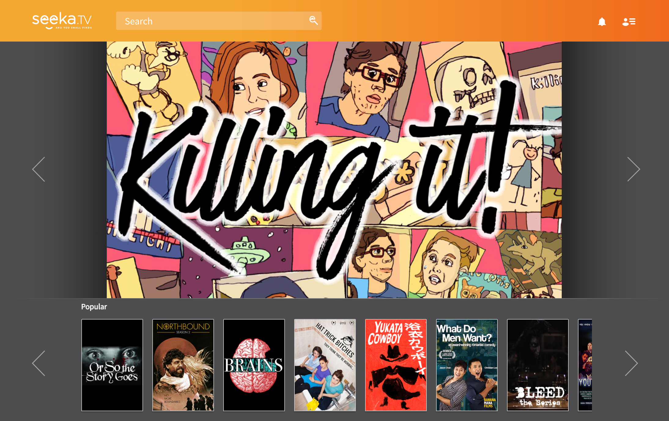
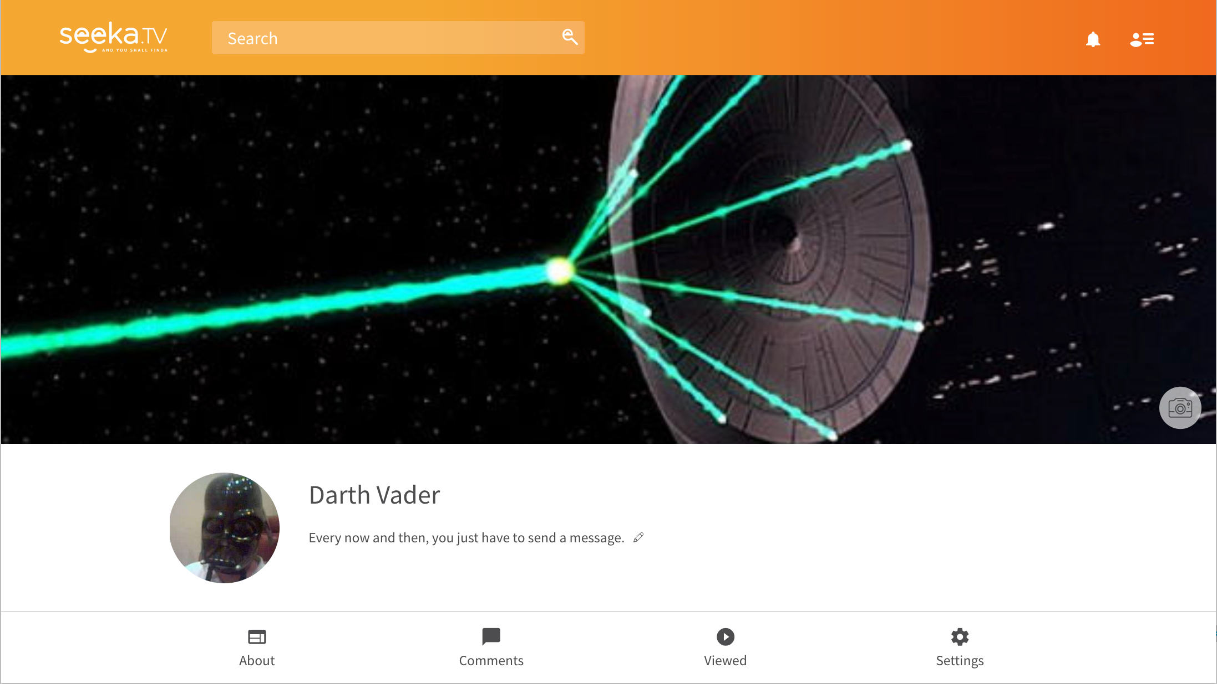
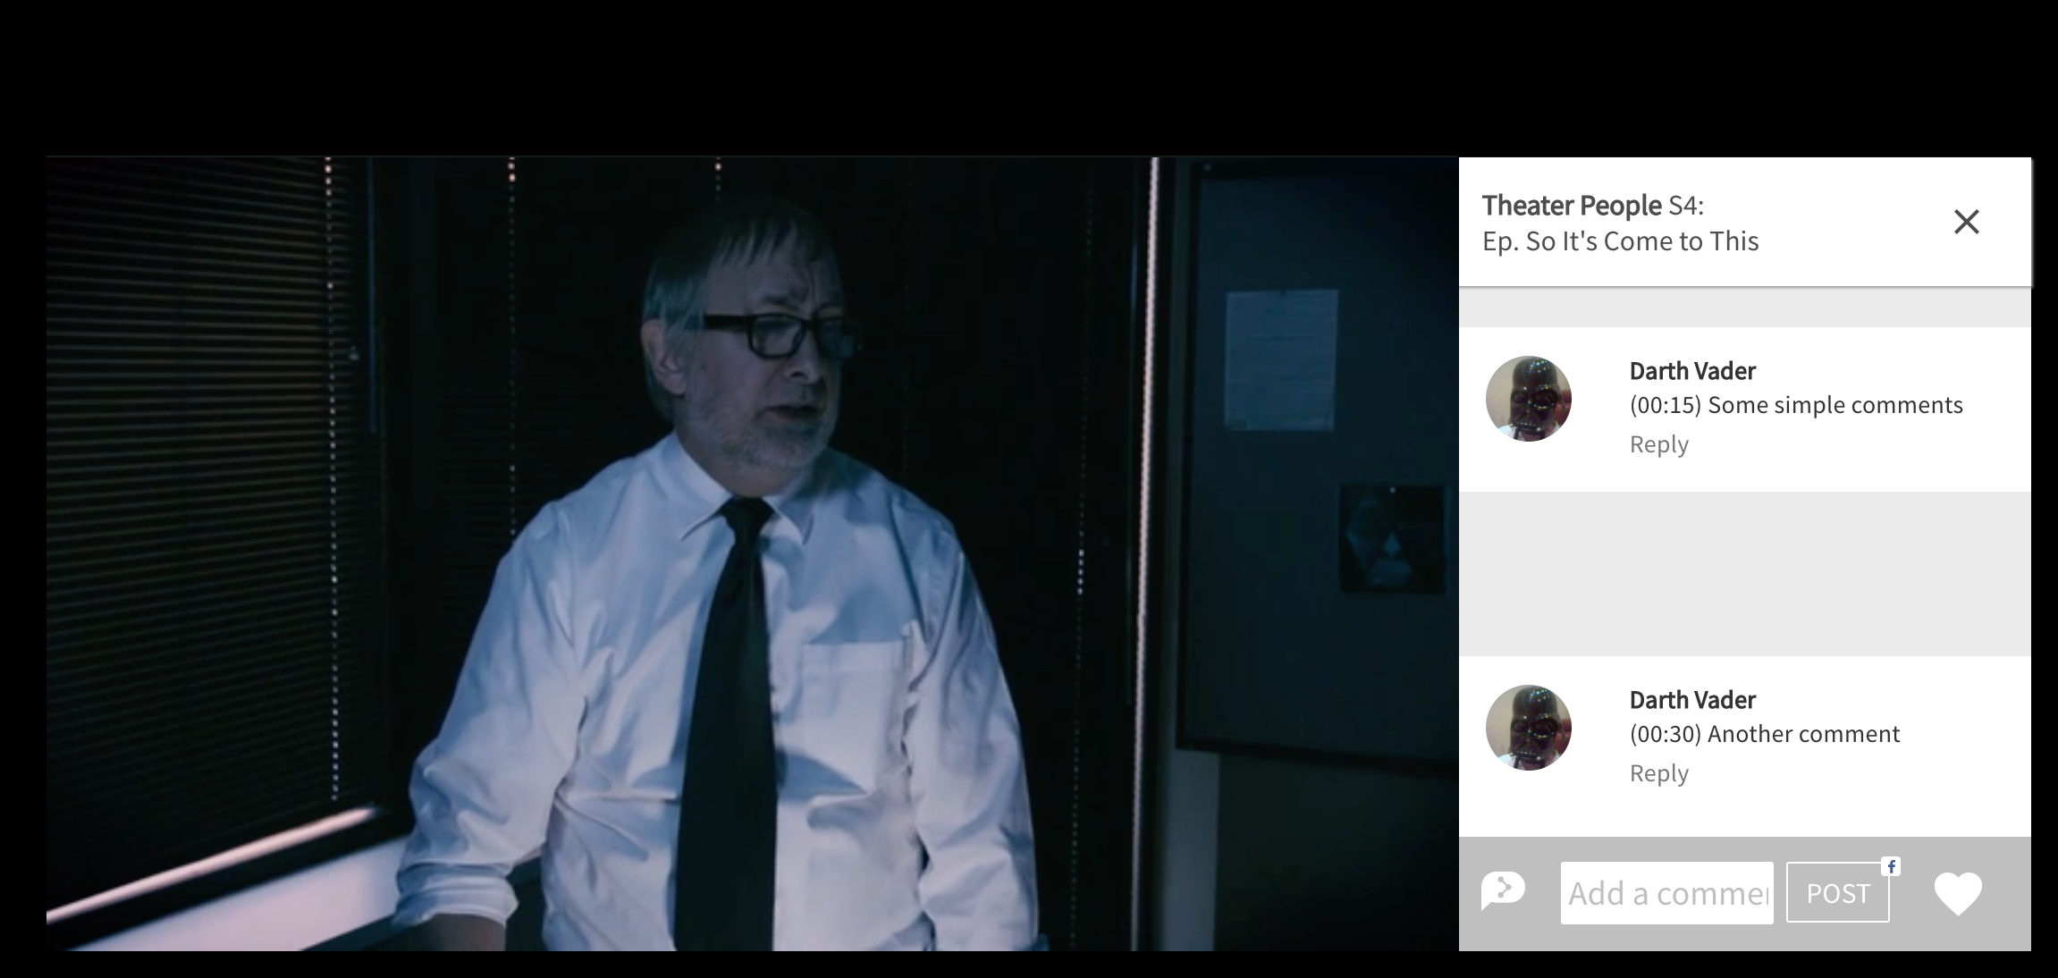
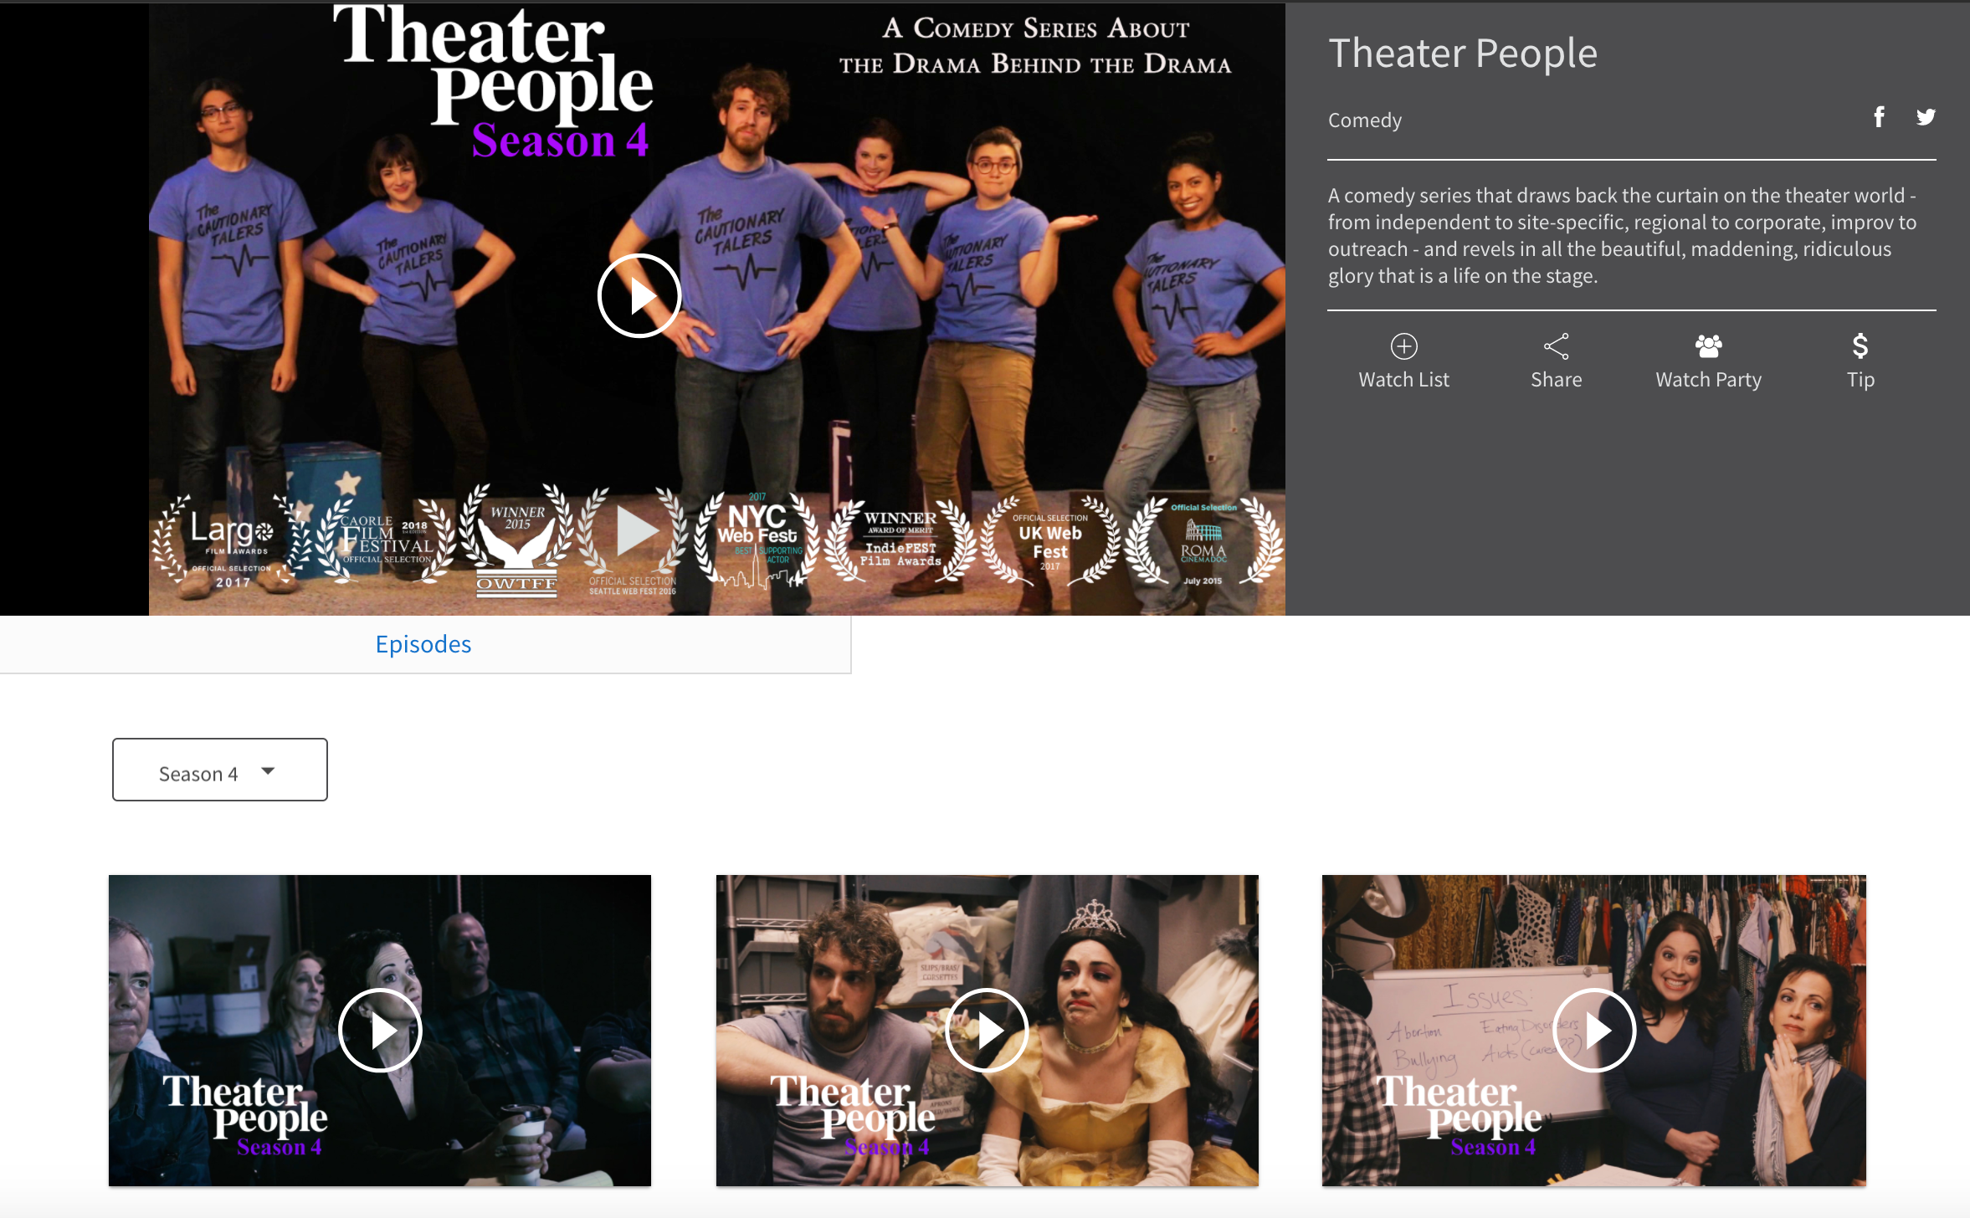

Slide 3
Profile Viewing History Comments etc.
Viewing Catalog 101
Individual Viewing Watch Parties Comments etc
Crowd Funding Watch Lists etc.

Slide 4
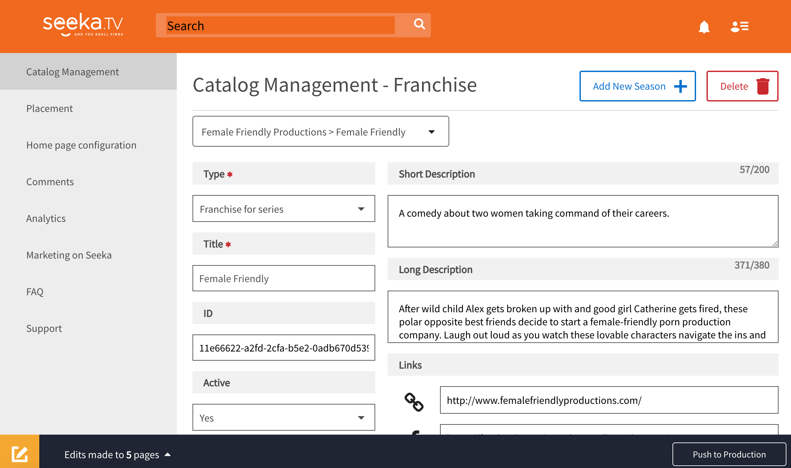
Create and manage content View comments/shares on content Analyze views, comments, SM, … Generate pluggable player placements etc.

Slide 5
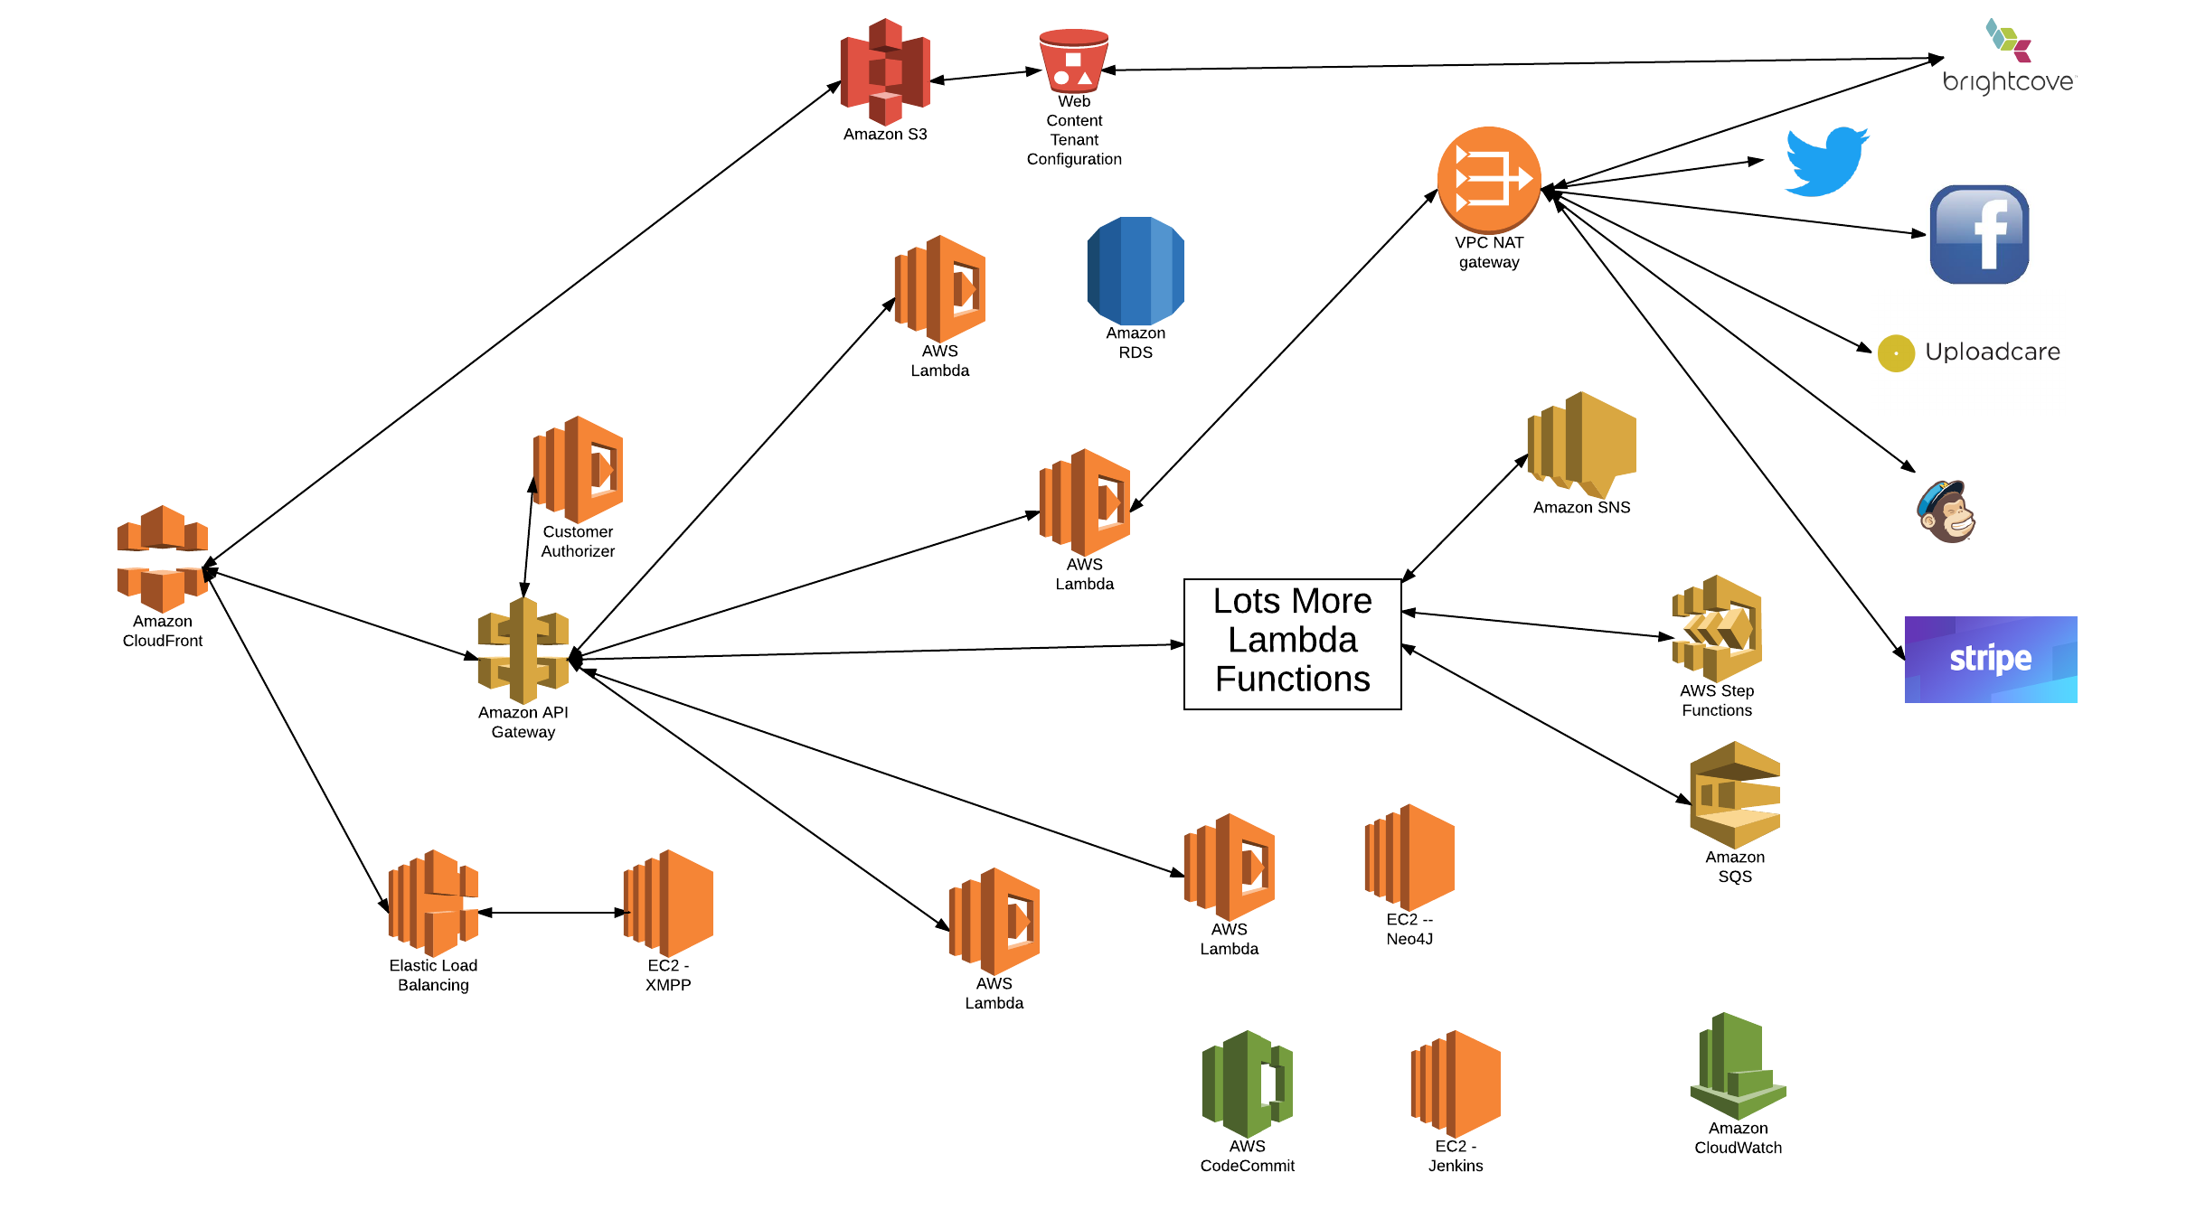
Seeka TV Architecture
Note
Not all connections shown
Probably forgot stuff
We have a couple of servers
XMPP
Neo4J (Graphene)
RDS

Slide 6
Seeka TV Architecture
Single DNS endpoint for multiple services SSL Certificate Tenant DNS redirection
Integrated URL/API name space
Note
Not all connections shown
Probably forgot stuff
We have a couple of servers
XMPP
Neo4J (Graphene)
RDS
XMPP Chat for watch parties and player controls.

Slide 7
Seeka TV Architecture
Web content
VPC->Outbound Calls
Background tasks on change
Content change promotion
Note
Not all connections shown
Probably forgot stuff
We have a couple of servers
XMPP
Neo4J (Graphene)
RDS
Verify potentially failed OPs
Basic catalog and user info

Slide 8
Seeka TV Architecture
Lambda implementing microservices for
Registration, authentication
User and profile management
Catalog and digital asset management
Watch parties
Commenting, tagging, …
Social media integration
Placement (business videos)
Tipping, crowd funding
Multi-tenant management
Other stuff I forgot
Note
Not all connections shown
Probably forgot stuff
We have a couple of servers
XMPP
Neo4J (Graphene)
RDS

Slide 9
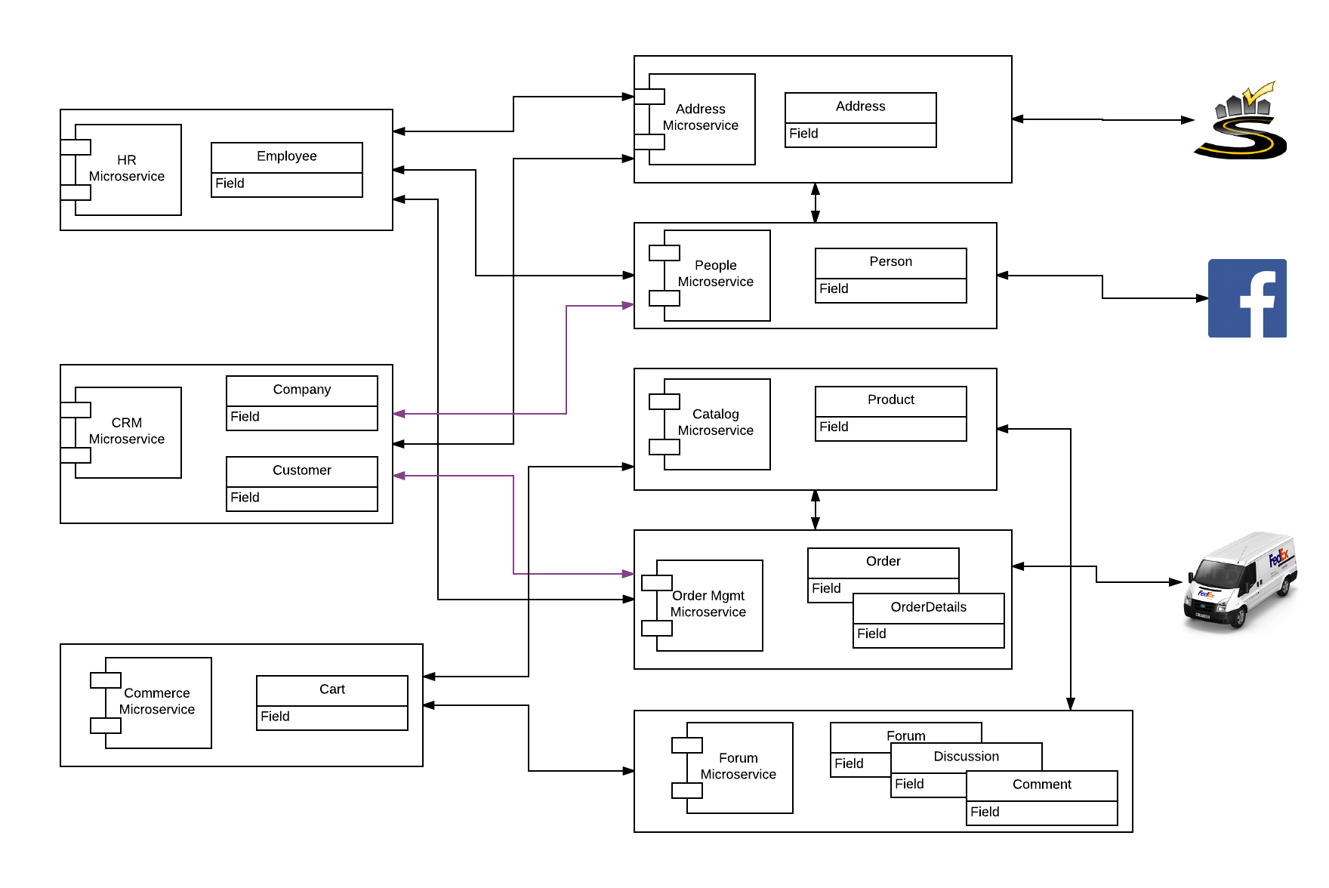
E6998 – Microservice and Cloud Applications Microservices Model
We only accomplished a fraction
Address
Person
OAuth2
Some composite microservice functions

Slide 10
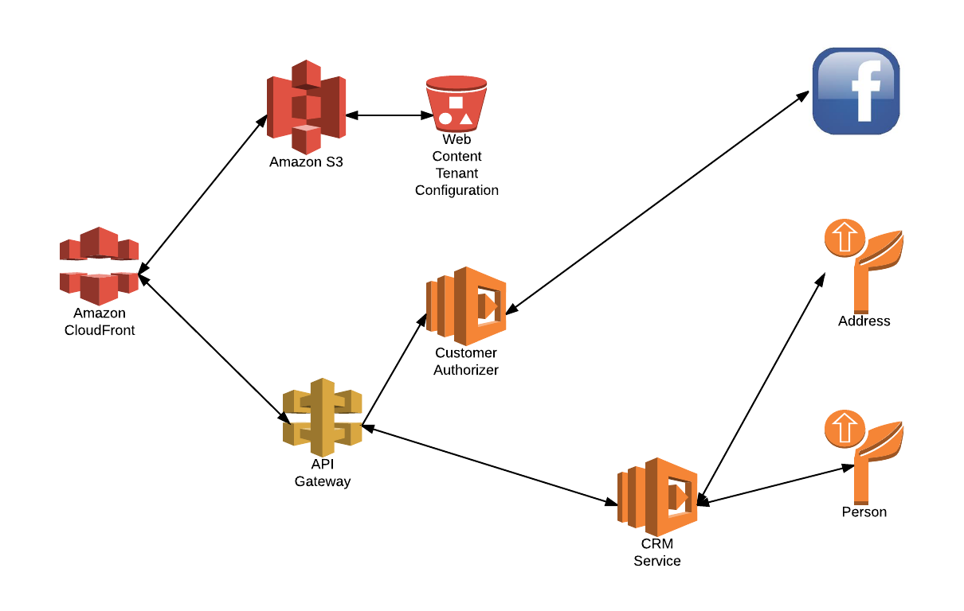
E6998 – Microservice and Cloud Applications Component Model

Slide 11
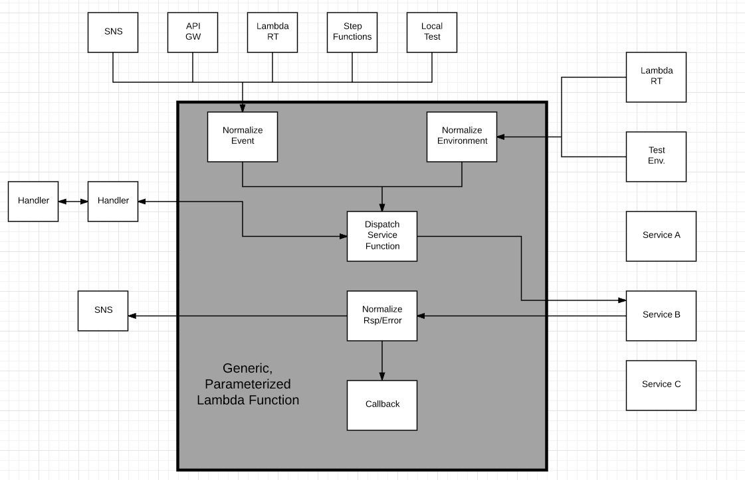
Design Pattern – Generic Lambda Function
Options
In zip file
Separate Lambda
Config info
Added to Lambda
Env Variable
From S3

Slide 12
Lessons Learned
Serverless is much more than Lambda functions/function.
Think of the environment the way I drew it. A bunch of icons.
If you can configure and program with a web browser, and you do not manage hardware, SW, upgrade, etc. → It is serverless.
The environment is like a massive programmable wiki of /URLs
Productivity
There is significant productivity, especially initially, by eliminating all HW and SW server configuration and management.
The stateless model becomes incredibly productive but requires evolving from a more traditional microservice/service/application model to a event-function-event model.
There are a lot of subtle configuration settings and interactions between elements, and this is within a single environment. Azure-IBM-Google-AWS-… terrifies me.

Slide 13
Research Opportunities
Service composition, even with SWF and Step Functions, is too tedious. There are three, inherently graphical approaches to composition
Structure
Data/event flow
Control flow
These are scattered all over the place in code, service configs, …
Serverless/functional systems are evolving to a pattern
(“URI”, “Verb”, data) → function. The function can be
Lambda function
CloudFront “executing” based on configuration information
API Gateway running integrations
etc.
But, there is no way to think about the environment this way.
Bunch of point editors.
Limited support for dynamic binding based on properties
End-to-end correlation of request flows.
Performance/availability root causes

